Slide 1
Lecture 13 Shortest Path

Slide 2

Shortest Path problem
Given a graph G, edges have length w(u,v) > 0.
(distance, travel time, cost, … )
Length of a path is equal to the sum of edge lengths
Goal: Given source s and destination t, find the paths with minimum length.

Slide 3
Designing the algorithm
What properties do shortest paths have?
Claim: Given a shortest paths from s to t, any sub-path is still a shortest path between its two end-points.
Which basic design technique has this property?
… …

Slide 4
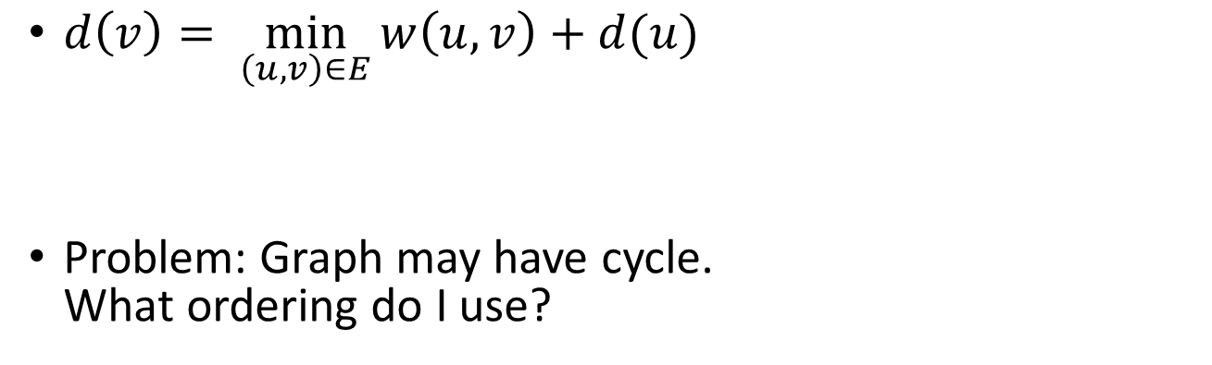
Shortest Path by Dynamic Programming
$d\left(v\right)= \min_{\left(u,v\right)∈E}{w\left(u,v\right)+d(u)}$
Problem: Graph may have cycle. What ordering do I use?
Length of last step
Shortest Path to a Predecessor

Slide 5
Dijkstra’s algorithm
Main idea: The correct ordering is an ascending order of distance from source.
Intuition: To get to a point v, if the last step of shortest path is (u, v), then u should always be closer to s than v.
➔ If I have computed shortest paths for all vertices that are closer to s than v, then I’m ready to compute shortest paths to v.

Slide 6
Dijkstra’s algorithm
Dijkstra(s)
initialize dis[u] to be all infinity, prev[u] to be NULL
For neighbors of s, initialize dis[u] = w[s,u], prev[u] = s
Mark s as visited
FOR i = 2 to n
Among all vertices that are not visited, find the one with smallest distance, call it u.
Mark u as visited
FOR all edges (u,v)
IF dis[u]+w[u,v] < dis[v] THEN
dis[v] = dis[u]+w[u,v]
prev[v] = u.

Slide 7
Running time
To analyze the running time of a graph algorithm, usually we want to analyze what is the average amount of time spent on each edge/vertex
For Dijkstra
We need to find the closest vertex n times.
We need to update weight of edges m times.
Naïve implementation: O(n) per vertex, O(1) per edge
Use a binary heap: O(log n) per vertex and edge.
Best: Use Fibonacci heap, O(log n) per vertex, O(1) per edge. Total runtime = O(m + nlog n)

Slide 8
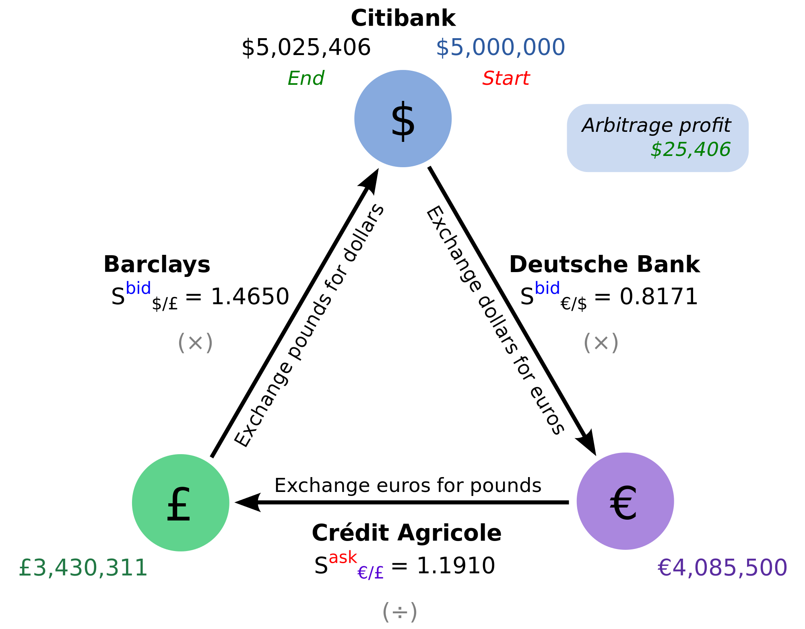
Shortest Path with negative edge length
What is w(u,v) can be negative?
Motivation: Arbitrage
Image from wikipedia

Slide 9
Modeling arbitrage
Suppose u, v are different currency, exchange rate is C(u,v) (1 unit of v is worth C(u,v) units of u)
Let length of edge w(u,v) = log C(u,v)
Length of a path = log of the total exchange rate
Shortest path = best way to exchange money.
Negative cycle = arbitrage.

Slide 10
How to compute shortest path with negative edges?
Claim: Given a shortest paths from s to t, any sub-path is still a shortest path between its two end-points.
Is this still true?
Dijkstra: If I have computed shortest paths for all vertices that are closer to s than v, then I’m ready to compute shortest paths to v.
Is this still true?

Slide 11
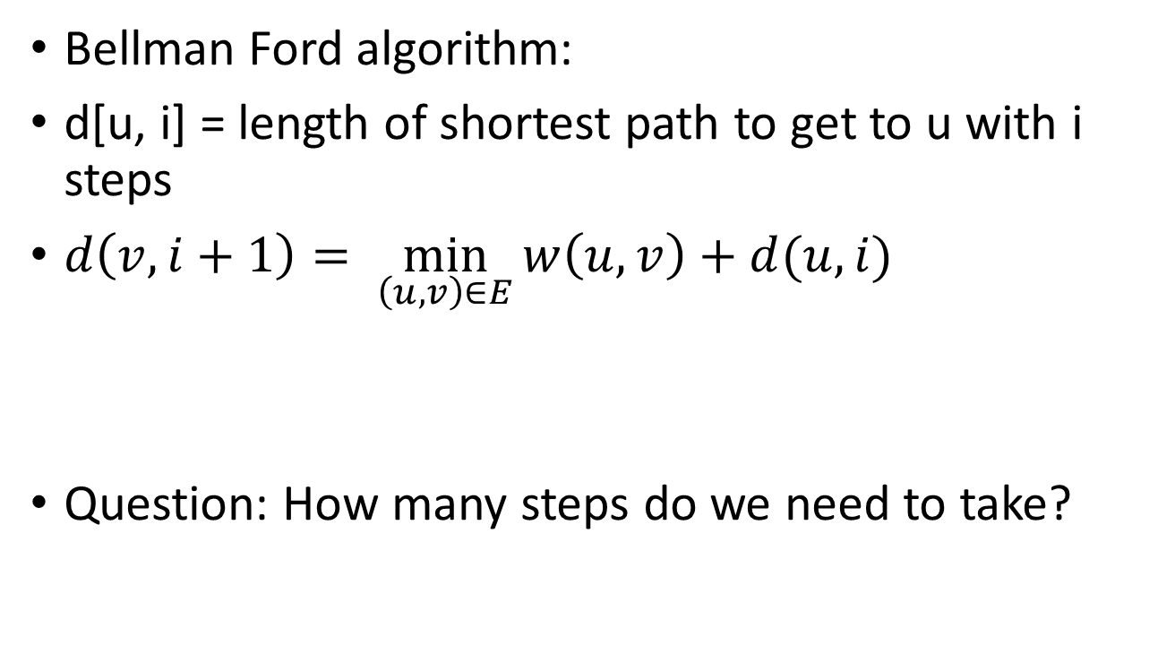
Approach: dynamic programming with steps
Bellman Ford algorithm:
d[u, i] = length of shortest path to get to u with i steps
$d\left(v,i+1\right)= \min_{\left(u,v\right)∈E}{w\left(u,v\right)+d(u,i)}$
Question: How many steps do we need to take?
Length of last step
Shortest Path to a Predecessor

